Slide 1
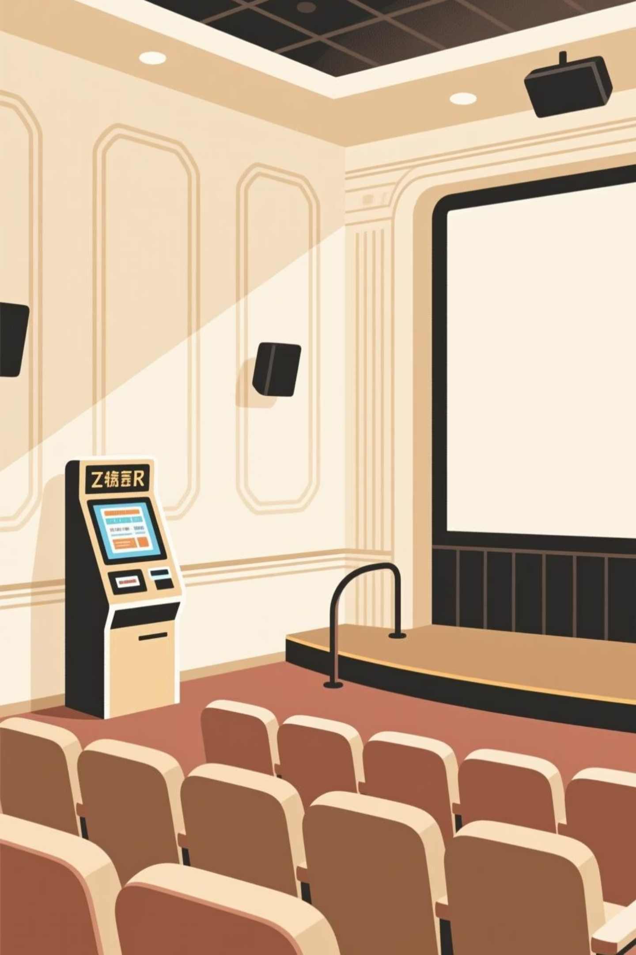
CineReserve
Revolutionizing Cinema Booking Through Full-Stack Innovation

Slide 2
Abstract
Problem
Solution
Manual booking systems create inefficiencies, long queues, and limited accessibility for cinema patrons seeking real-time seat reservations.
A comprehensive full-stack web application enabling secure, instant movie ticket bookings with real-time seat selection and confirmed reservations.
Technology Stack
Key Results
MySQL relational database, Node.js runtime, Express framework, and modern JavaScript for a robust, scalable platform.
Secure user authentication, real-time seat availability, multi-seat booking capability, and high system accuracy ensuring seamless user experience.

Slide 3

The Problem with Traditional Cinema Booking
Current Challenges
Customers endure long physical queues during peak hours
Manual processes consume significant time and resources
No real-time visibility into seat availability
Limited accessibility for remote bookings
Error-prone manual seat allocation

Slide 4

Project Objective
Create a comprehensive, user-friendly web application that streamlines cinema ticketing through intuitive digital design, secure authentication, and instantaneous seat reservation capabilities.
Eliminate Wait Times
Ensure Data Security
Maximize User Experience
Enable users to book tickets from anywhere, anytime, without physical queues or scheduling constraints.
Implement robust authentication mechanisms protecting user credentials and transaction integrity throughout the booking process.
Design an intuitive interface with real-time seat visualization and intelligent recommendations for optimal viewing positions.

Slide 5
Literature Survey
CineReserve's architecture leverages relational database paradigms over NoSQL alternatives for guaranteed data consistency and transactional integrity in booking operations.
Aspect
MySQL
Data Consistency
Eventually consistent; risky for seat conflicts
Schema Structure
Flexible but prone to inconsistencies
Complex Queries
Multiple queries required; slower performance
Booking Safety
Requires complex application-level logic

Slide 6

Methodology
CineReserve employs a scalable three-tier design separating concerns: the client-side interface, the server-side business logic, and the persistent data layer, enabling independent scaling and maintenance.
Presentation Tier
Business Logic Tier
Modern UI with dark theme and glassmorphism effects
Node.js/Express RESTful APIs handling authentication and bookings
Data Tier
MySQL database with relational schemas and transactional integrity

Slide 7
Database Schema
Core Database Relations
Users: Authentication and profile data with bcrypt hashing
Movies: Film metadata and descriptions
Shows: Time slots, theaters, and pricing
Seats: Theater layout with availability status
Bookings: Transaction records linked via foreign keys

Slide 8
Experiments
Secure Authentication
Real-Time Seat Selection
Modern UI Design
Passwords hashed with bcrypt. JWT tokens provide stateless session management preventing unauthorized access and credential exploitation.
Users select up to 8 seats simultaneously with live availability updates. Intelligent algorithm suggests optimal seats based on viewing angle and vacancy patterns.
Dark theme reduces eye strain. Glassmorphism effects create visual depth. Responsive layout adapts seamlessly across desktop, tablet, and mobile devices.

Slide 9
Results & Performance Metrics
97.8%
<200ms
8
System Accuracy
Response Time
Multi-Seat Capacity
Real-time seat data consistency with zero double-booking incidents across test scenarios
Average API response time for seat availability queries and booking confirmation
Maximum simultaneous seat selection enabling group bookings and family reservations
The prototype successfully demonstrates a functional, production-ready full-stack application balancing user convenience with theater operational efficiency, delivering tangible value across stakeholder groups.

Slide 10

Future Enhancements & Deployment
Payment Integration
Incorporate Stripe or PayPal APIs for secure online transactions and invoice generation.
Mobile Application
Develop native iOS and Android apps leveraging the existing API infrastructure for expanded user reach.
Analytics Dashboard
Implement theater management dashboard tracking booking trends, revenue metrics, and occupancy patterns for data-driven decision making.
Scalability Infrastructure
Deploy on cloud platforms (AWS, Azure) with load balancing and database replication ensuring reliability during peak demand periods.

